Slide 1
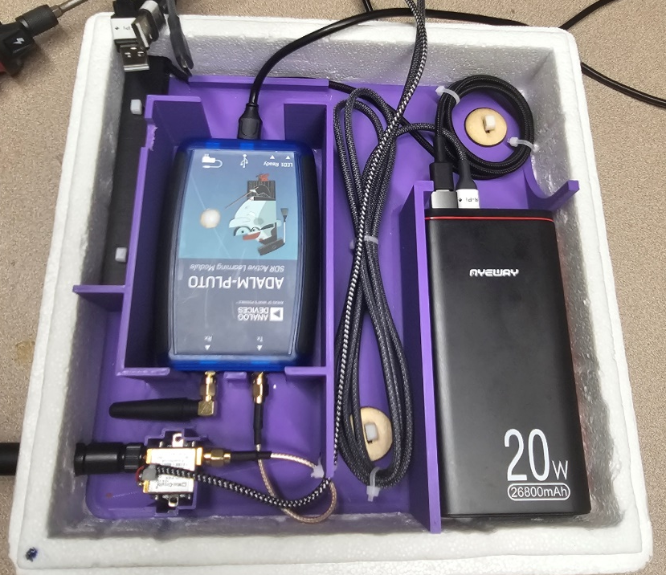
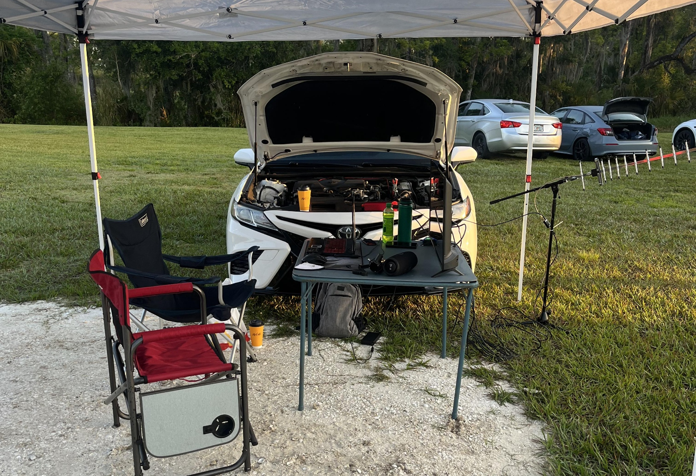
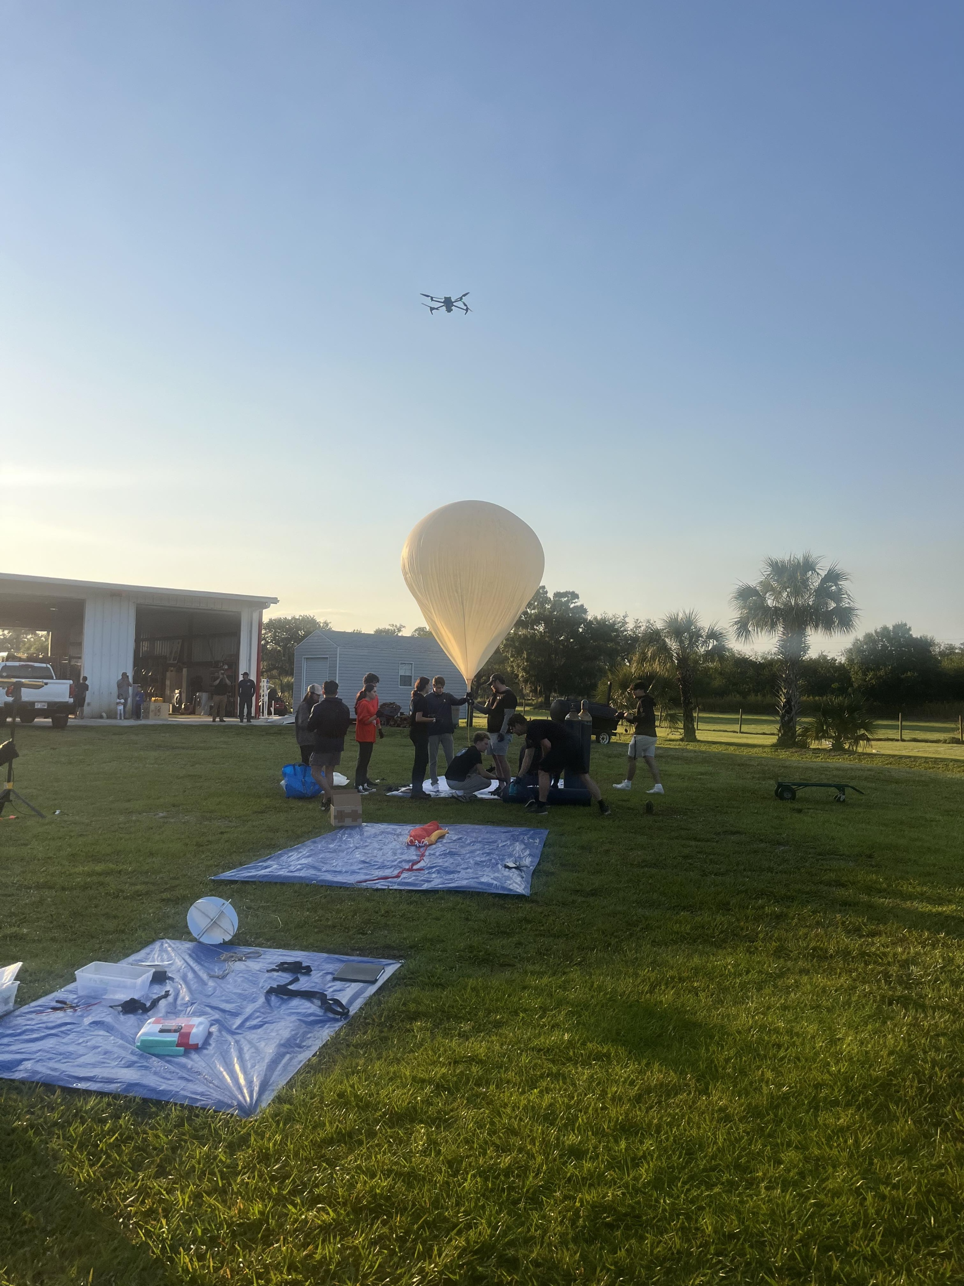
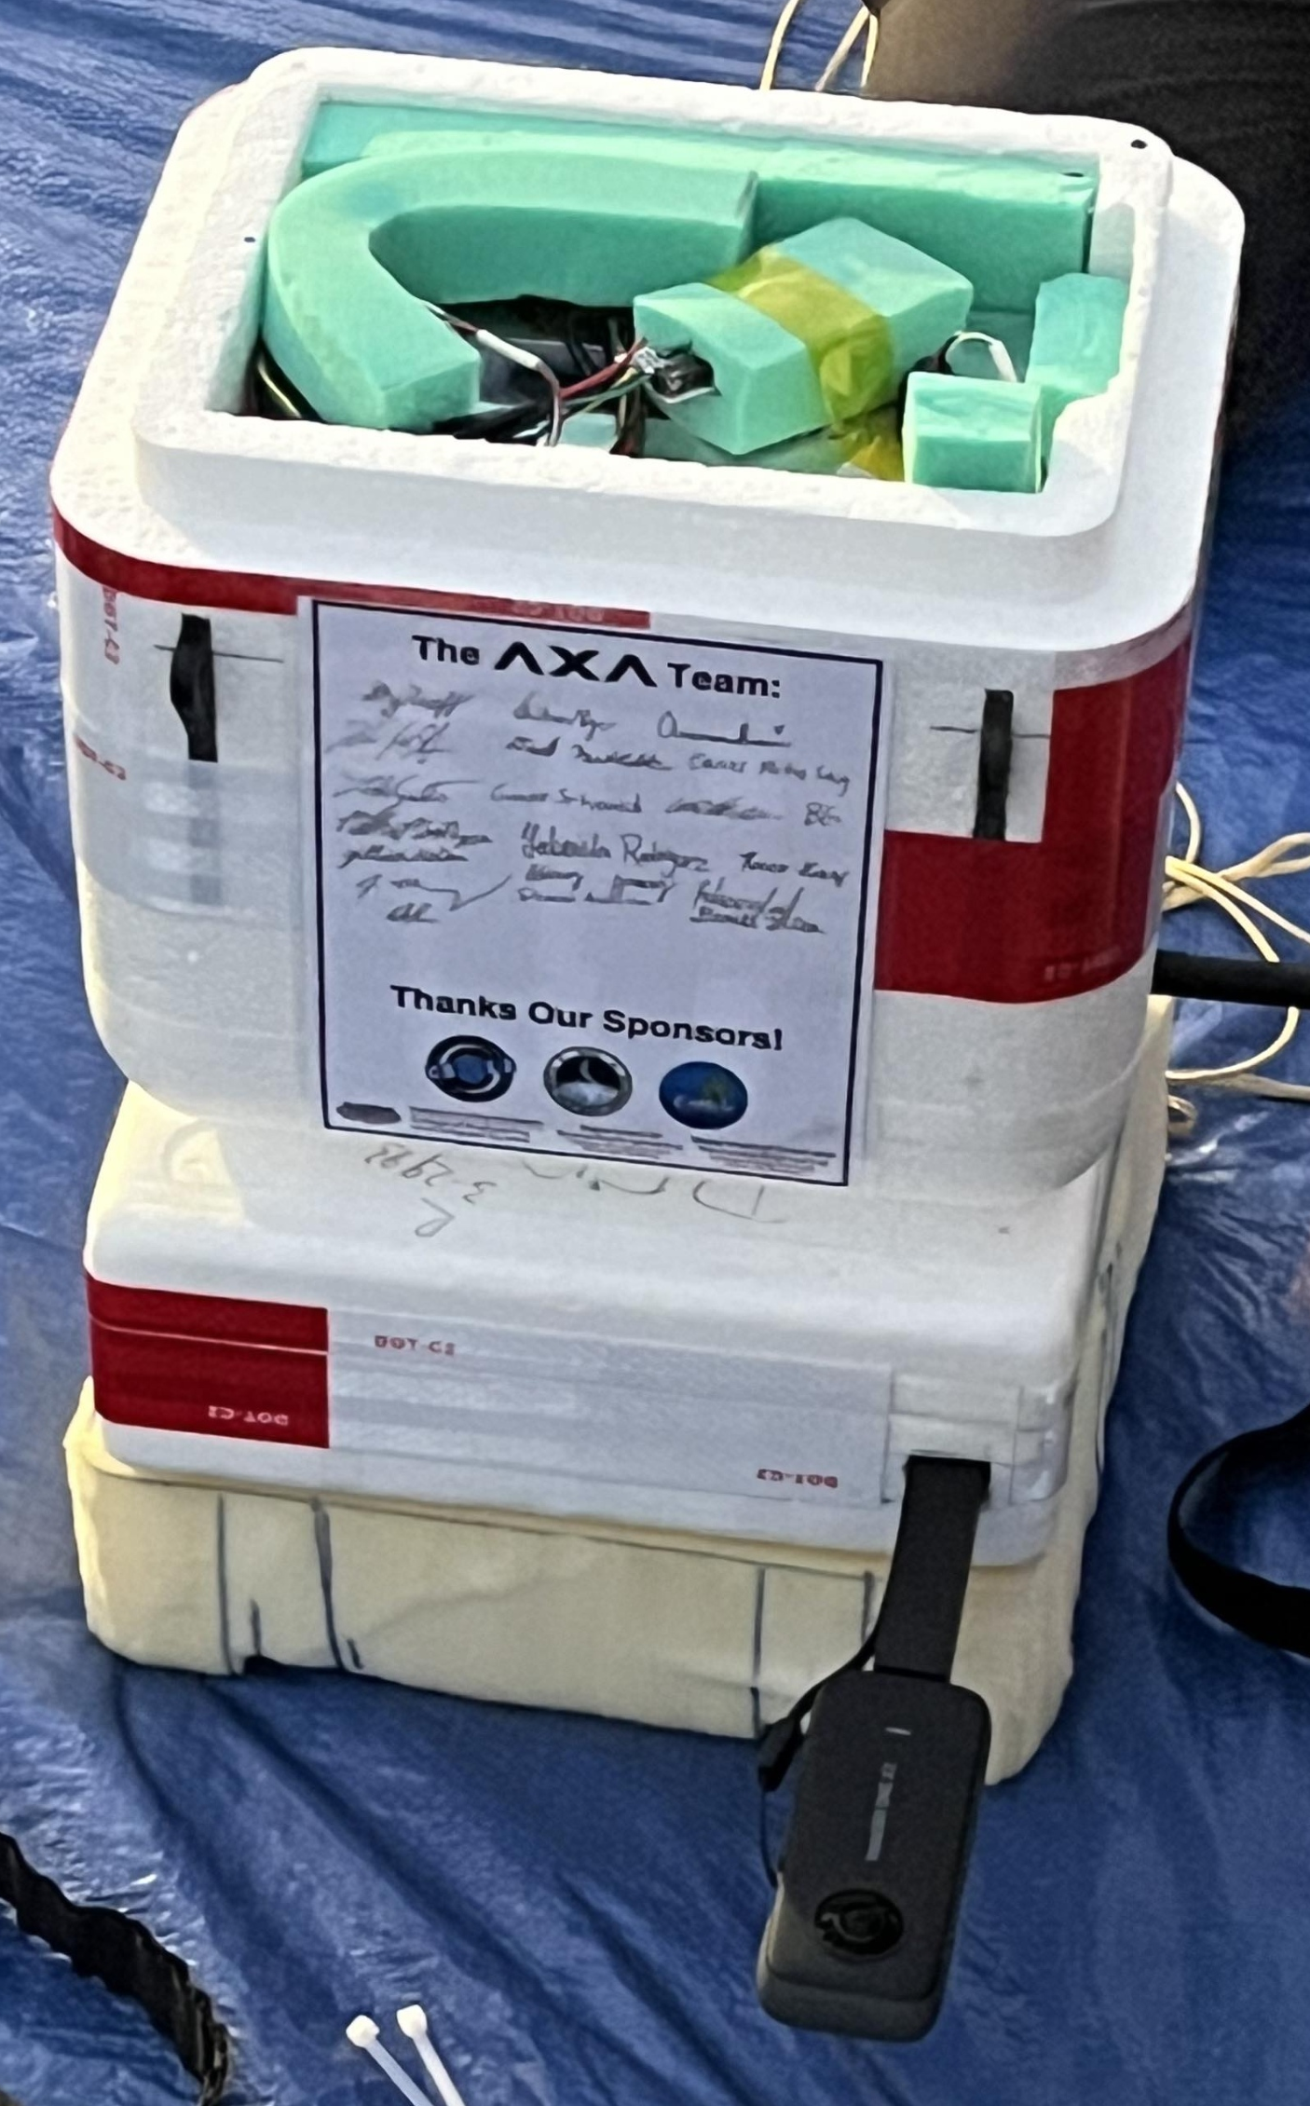
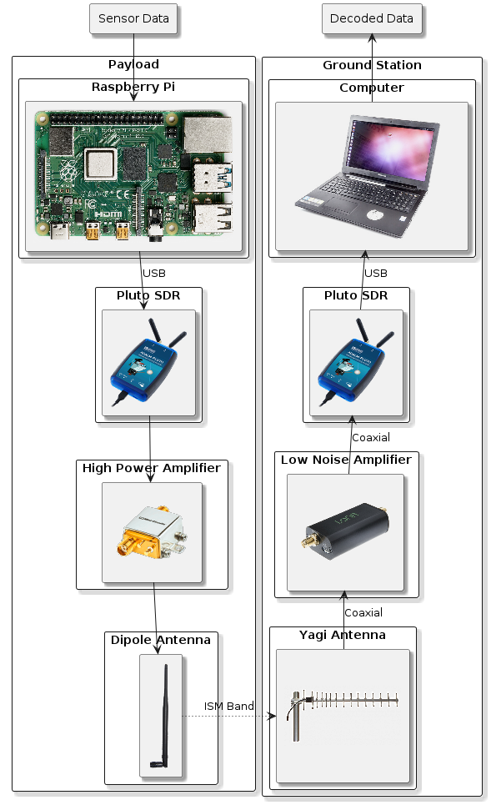
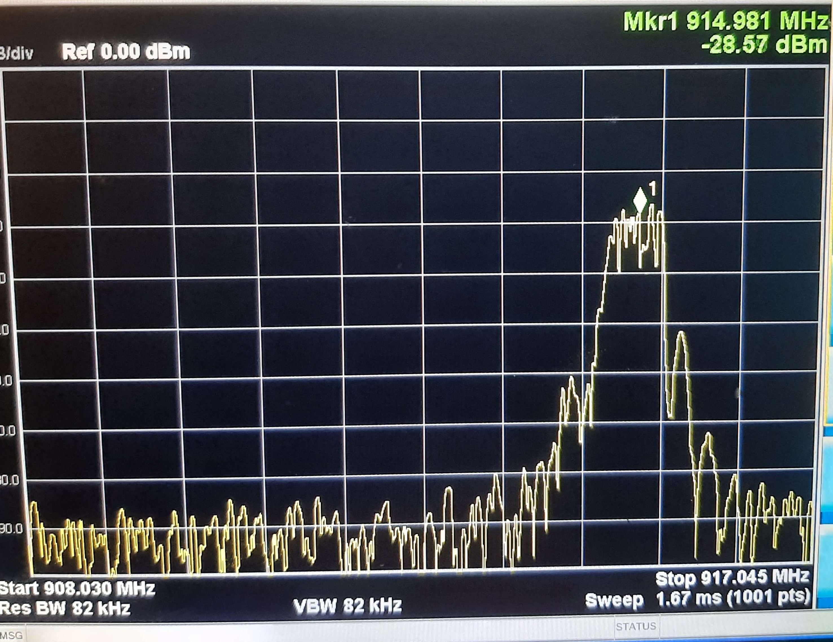

Software-Defined Radio for CubeSat Applications
Team Members
Faculty Advisor:
Jonathan Mazurkiewicz
Morgan Benavidez
Zee Fisher
Carson Van Buren
David Miloseski
Dr. Xiangnan Zhong
Dr. Fatima Boujarwah
Dr. Sree Ranjani Rajendran
Department of Electrical Engineering & Computer Science
#9
Sponsored by: Dr. George Sklivanitis
Problem Statement
Each satellite is unique and has specific mission requirements. The solution to these constraints is proprietary and particular to the satellite that is being developed. One of the primary difficulties is establishing a communication link from the satellite to Earth with a specific modulation scheme and frequency for the mission’s requirements. RF transmissions from space to Earth must be resilient to noise and adverse effects introduced to the system by the distance, atmospheric conditions, and other factors while still maintaining enough signal strength to be recovered. Component selection and modulation scheme for the payload and ground station, simulation of the communication link, and adequate testing before launch are key challenges. By using Software-Defined Radio, a flexible, cost-effective, and rapidly prototyped solution can be created that is capable of effective Digital Signal Processing while also taking advantage of the reprogrammable nature of FPGAs to achieve the mission.
Results
Using Link Budget Analysis, we were able to simulate real-world conditions at a distance of 100,000 feet. After accounting for Free Space Path Loss (FSPL) and other parameters that degrade signal strength, it was estimated that the received Eb/No was 21.5 dB, C/N of 35.5 dB, with a margin of 7.5 dB, closing the link in the simulation. This was achieved using BPSK modulation with a 915 MHz carrier frequency, amplified by the HPA (+14 dBm) and omni-directional dipole antenna (+3 dBm) to be received by the directional yagi antenna (+16 dBm) on the ground station, then amplified further by the LNA (+20 dBm). Sensor information was packetized with additional header information to assist in demodulation. By using 915 MHz as a carrier frequency, no license was needed and allowed rapid prototyping and simplified component selection. By leveraging open-source software Gnu Radio, Docker containers to manage software compatibility, and the reprogrammable nature of FPGAs and SDRs, the modulation scheme can easily be adapted to suit other needs per mission requirements. The payload was tested live on April 6th and data was transmitted and demodulated at our mobile ground station.
Conclusions & Impact
We have proved that rapidly prototyping a communication link using signal processing to transmit data is possible using SDR. This approach not only reduced costs but also enhanced adaptability and accessibility. Since our work is available to the public, others who are interested in establishing a communication link may reference our work and improve upon it further. We have learned that in development, software compatibility is an enormous constraint that can be managed effectively with Docker containers. In addition, creating adequate methods for pointing the directional yagi antenna during launch would greatly increase the mission’s effectiveness. In the future, implementing a more complex modulation scheme like QPSK while managing signal-to-noise ratio (SNR) could result in better spectral efficiency, bandwidth utilization, and higher data rates. Forward Error Correction (FEC) could also aid in reducing errors at the ground station. Considering what we have learned, future teams will have a much better picture of what it takes to create a robust communication link using Software-Defined Radio for CubeSats.

